Slide 1
Intro to Linux

Slide 2
Objectives
Describe the purpose and role of an operating system
Examine key concepts of the Linux architecture
Navigate and manipulate the Linux filesystem using basic CLI commands

Slide 3
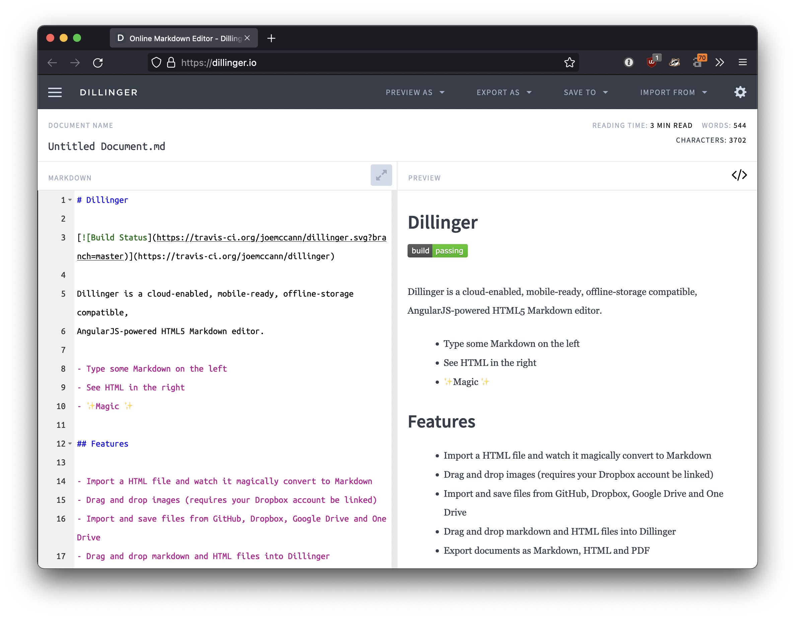
Side Quest
Markdown files¹
VS Code Extensions (markdown viewer, pdf reader)
Notes:
¹https://www.markdownguide.org/getting-started/

Slide 4
What is an operating system?
Main “driver” of a computer
Controls programmatic access to hardware resources

Slide 5
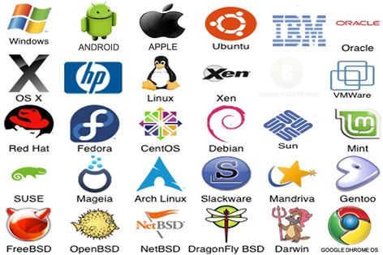
What are some Operating Systems that are out in the wild?

Slide 6

Linux
Meet Tux

Slide 7
Linux
What is it?
Common Distributions²
Family of operating systems
Based off Unix (an AT&T OS)
Designed to be compatible with Unix applications
Main kernel written by Linus Torvalds (famously ill-tempered opinionated)³
Open source and available freely¹
Debian / Ubuntu
Fedora
openSUSE
Arch
Gentoo
Alpine
Notes:
¹ https://git.kernel.org/pub/scm/linux/kernel/git/torvalds/linux.git/
² https://en.wikipedia.org/wiki/Linux_distribution#Widely_used_GNU-based_or_GNU-compatible_distributions
³ https://github.com/corollari/linusrants

Slide 8
Windows Subsystem for Linux

Slide 9
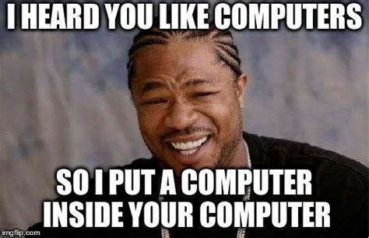
Actually, wait…
Virtual machines…
  A “fake” OS inside another OS
  The “host” OS presents virtual (fake) devices to the “guest” OS
  Remember, everything is just interpreted 1s and 0s
  Mice, keyboards, etc, are all just 1s and 0s.
  We’ll talk more about it in the cloud lessons

Slide 10
Windows Subsystem for Linux
A Linux VM running as a guest on a Windows host
That Linux VM hosts “containers” for each distribution
The Windows filesystem is mounted into the Linux filesystem
Has some idiosyncrasies but works well for our purposes

Slide 11
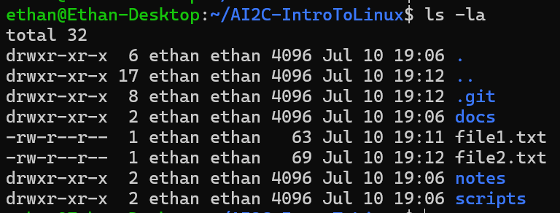
Filesystems
A filesystem is a system that handles files… (and folders)
OS’s provide a variety of utilities to manage the filesystem
Notes:
Go in-depth on the output of the –la command
Ls – command
-la – arguments / flags
Total 32 – number of blocks used by this tree
First column - dir/file, owner, group, others permissions
Second column – number of hardlinks
Third column – owner
Fourth column – group
Fifth column – space taken by file (metadata for directories)
Sixth(ish) columns – last modified time
Last column – file/directory name

Slide 12
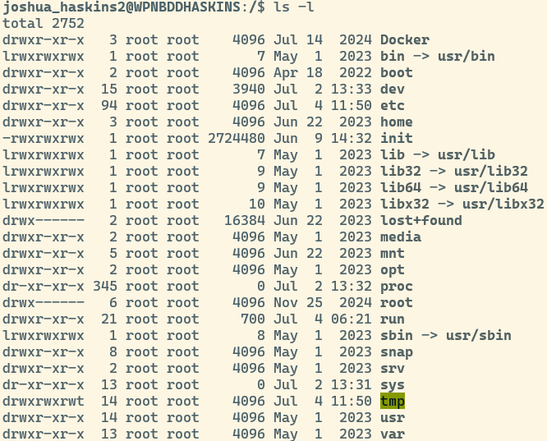
The Linux File System
Everything starts at a single root /
  No drive letter
Common layout
  /bin
  /etc
  /home
  /var
  …
Forward slashes
File extensions NOT required!!!
File names are case sensitive and should not contain spaces…

Slide 13
Paths – Absolute
Absolute Path
  Specifies every directory that needs to be traversed (double clicked) to access a particular location
  Assumes you are starting from the very top / beginning
  C:\users\me\courses\cy355\lesson_slides\lesson_04
  /home/users/me/courses/cy355/lesson_slides/04

Slide 14
Paths – Relative
Some special chars:
  . – current directory
  .. – parent directory
A relative path assumes you are already somewhere in the file system
Provides instructions from your current location to your destination
You are currently in C:\users\soldier.joe\courses\AI400 and want to get to today’s lesson slides located at
C:\users\soldier.joe\courses\cy355\lesson_slides\lesson_04
To get there…
..\cy355\lesson_slides\lesson-4

Slide 15
Filesystem Operations
Command | Description
pwd | Print working directory
cd | Change directory (equivalent of double-clicking a folder)
ls | List contents of a directory (-l for detailed view, -a for all files)
cp | Copy a file or directory (like "copy and paste")
mv | Move or rename a file/directory (like "cut and paste")
touch | Update timestamp or create a new file
mkdir | Create a new directory
rm | Remove a file
cat | Print the contents of a file to the terminal
Notes:
* These commands are destructive in that there is no going back. If you delete a file it is gone. If you overwrite a file, that file is gone.

Slide 16
Hands-On #1
Terminal Overview
Filesystem Commands

Slide 17

Other common utilities
grep
wc
ssh
scp
|, >, >>, <, &&, ||

Slide 18
Finding help…
Often, `command --help`
Other times, `man command`
“Manual pages” -> “manpages” -> “man”
Of course:
  Documentation
  Stackoverflow
  Reddit
  LLMs
  Google

Slide 19
Regular Expressions
If you want to learn more about grep patterns…
  Regular expression syntax cheat sheet - JavaScript | MDN
  regex101: build, test, and debug regex
  Top 15 Commonly Used Regex - Digital Fortress

Slide 20
Hands-On #2
Use the discussed utilities on a Linux system

Slide 21
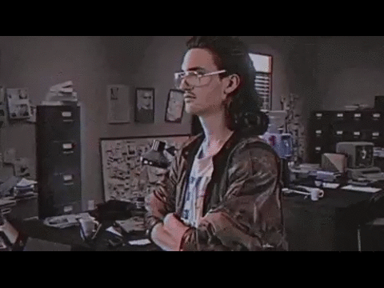
How are you feeling?

Slide 22
Useful Commands
history – linux command history
Ctrl+R (reverse search)
Ctrl+L (clear)
clear

Slide 23
Who Says…
Why would I ever use the terminal?
This is so slow!
Have you ever had to manipulate 10 servers? 100 servers? 1000 servers? In a GUI?

Slide 24
Questions

